Slide 1
Automation Testing
ZL Chen, SIoT DQA, Advantech

Slide 2
Agenda
Automation Testing Functional
Automation Testing Tools
Reliability Automation
Process Automation
Continuous Integration Structure

Slide 3
Automation Testing Functional
Cost Reduction
Repeatability
Programmable
Reusable
Quality
Reliability Automation
Process Automation
Improvement

Slide 4
Automation Testing Tools
Reliability Automation
Wi-Fi Frequency Switch Automation
Process Automation
Luminance Automation
Resolution Automation
Roaming Automation
Airplane ON/OFF Mode Automation
PXE Automatic Installation
ProgramIndex Automation

Slide 5
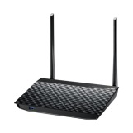
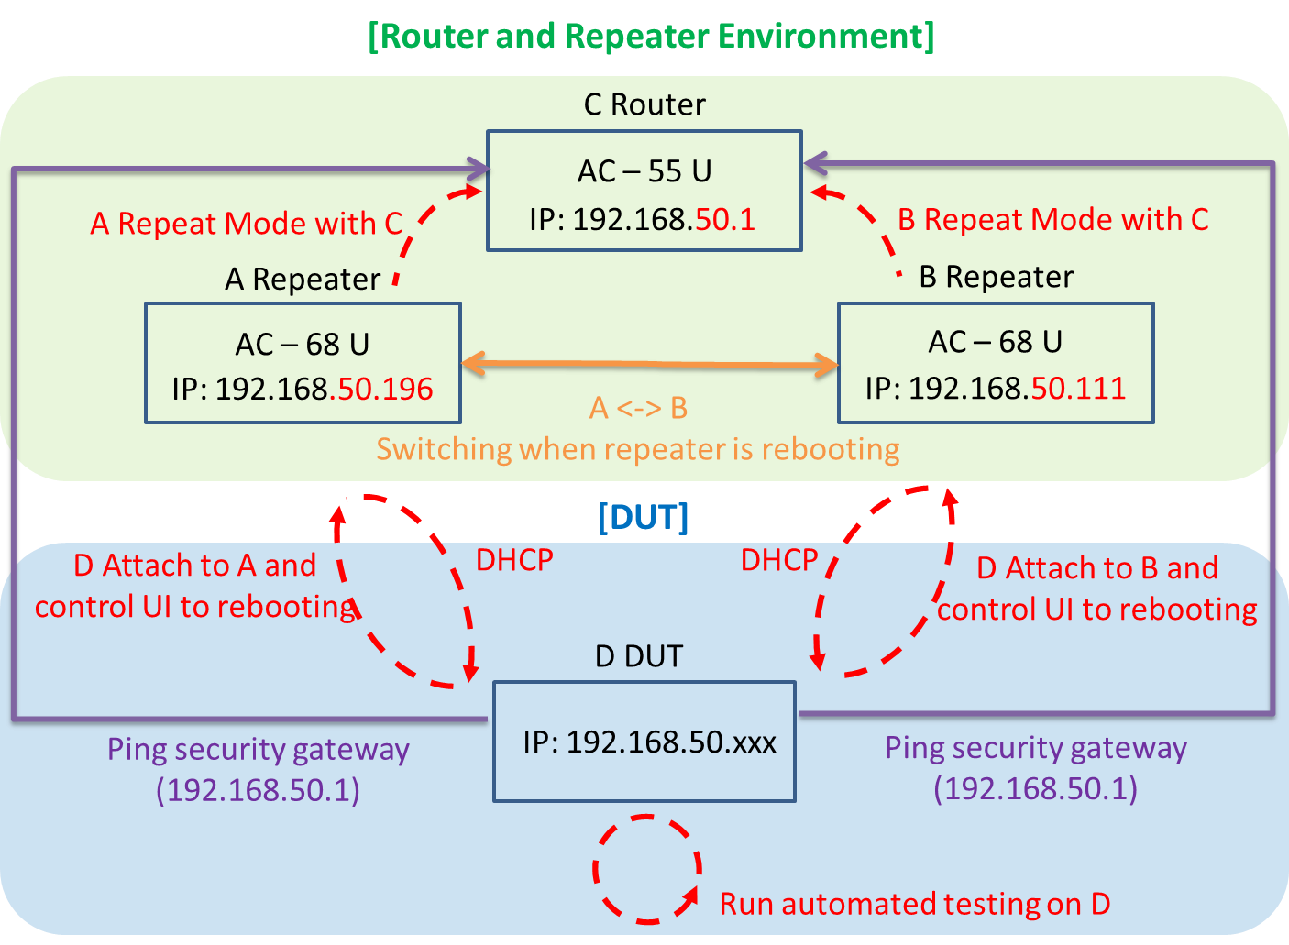
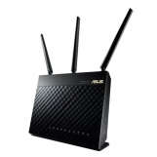
Roaming Automation
Demand
Auto Roaming
Auto Reboot
System Structure
Repeater Mode
AP Roaming

Slide 6
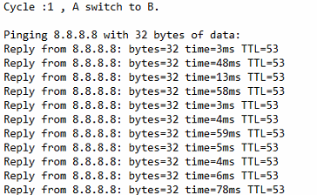
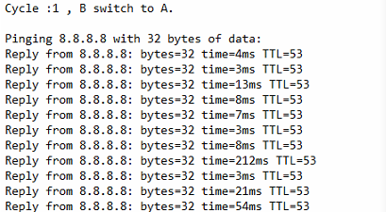
Roaming Automation - Log
The roaming’s ping log are as below:

Slide 7
Roaming Automation
Improvement
Reduce the manual testing errors.
In order to switch the AP process.
Accurately to capture the ping logs
Execute the long-term load testing.
Exceptions
AP Roaming 10 Times -> Digital Attenuator

Slide 8






Continuous Integration Structure
User
DUT
4. Run Test Script
1. Connect
3. Execute Test Script
5. Console Response
2. Trigger Jobs
6. Feedback Result
7. Mail
PC
CI Server
Test Cases Server

Slide 9
Go Together,
We Go Far and Grow Big

